Slide 1
Performance Management Process for Non-Union Staff
Refresher 2026

Slide 2
Agenda
Roles & Responsibility
The Process & Cycle
Planning & Documenting
Setting Objectives & Individual Development Plan
SMART Goals
Execution and Feedback
The Form
2026-2027 Timeline

Slide 3
Why Have a Performance Management Process?

Slide 4

Why Have a Performance Management Process?

Slide 5
Everyone has an important role in this process
Roles & Responsibilities
HR
People Manager
Team Members (all)
Design a best practice performance management process.
Set reasonable deadlines for completing each step in the process.
Provide training and ongoing support of the process.
Ensuring 100% participation.
Communicate Council’s strategic goals and cascade down to direct reports.
Assist employees in developing objectives.
Schedule regular 1:1 meetings to performance and objectives.
Deliver regular positive and constructive feedback.
Support your employees' professional and career development while making them accountable for it.
Submit your completed employee reviews by the designated deadline.
Work towards achieving individual objectives, which help the organization reach its objectives.
Take responsibility for your own professional and career development.
Seek support as required.
Keep a record of performance successes and challenges.
Complete Annual Review self-appraisal by the specified deadline.
Notes:
Use the performance management process as a valuable tool for supporting employee development and improvement.
If your employees sense a lack of interest on your part, they'll lose interest too.
When talking with your team about the process, be sure to emphasize its benefits, and encourage employees to take ownership of their own performance and development.

Slide 6
Town of Essex Performance Management Process
The Town’s Performance Management Process (PMP) will have three components:
1. Strategic Goals
2. Development Goals
3. Competency
Review
Established at the beginning of the PMP Cycle
Completed at the end PMP Cycle

Slide 7
Annual Performance Management Cycle
April/May
May
All Year
March/April
Strategic Goal
Setting
Plan & Document Objectives
Execution & Continuous Feedback
Evaluation
Goals Cascaded Down from Council thru the CAO/Director
Departmental/ Divisional Objective Setting for Year
Individual Objective Setting (Strategic & Development)
Documenting on Electronic Forms
Track & Monitor Progress
Continuous Coaching
Providing & Receiving Feedback
Conducting Frequent 1:1 Meetings, Modify Objectives as Needed (periodically, these can be informal)
Self Evaluation
Manager Evaluation
Performance Evaluation Discussion & Finalized Evaluation

Slide 8
Annual Performance Management Cycle
April/May
May
All Year
March/April
Strategic Goal
Setting
Plan & Document Objectives
Execution & Continuous Feedback
Evaluation
Goals Cascaded Down from Council thru the CAO/Director
Departmental/ Divisional Objective Setting for Year
Individual Objective Setting (Strategic & Development)
Documenting on Electronic Forms
Track & Monitor Progress
Continuous Coaching
Providing & Receiving Feedback
Conducting Frequent 1:1 Meetings, Modify Objectives as Needed (periodically, these can be informal)
Self Evaluation
Manager Evaluation
Performance Evaluation Discussion & Finalized Evaluation

Slide 9
Strategic Goals Cascade Down
Council
CAO/Director
Managers
Assistant Managers
& Supervisors
Staff
Success
Goals & Objectives

Slide 10
Annual Performance Management Cycle
April/May
May
All Year
March/April
Strategic Goal
Setting
Plan & Document Objectives
Execution & Continuous Feedback
Evaluation
Goals Cascaded Down from Council thru the CAO/Director
Departmental/ Divisional Objective Setting for Year
Individual Objective Setting (Strategic & Development)
Documenting Goals
Track & Monitor Progress
Continuous Coaching
Providing & Receiving Feedback
Conducting Frequent 1:1 Meetings, Modify Objectives as Needed (periodically, these can be informal)
Self Evaluation
Manager Evaluation
Performance Evaluation Discussion
CAO Calibration
Finalized Annual Performance Evaluation

Slide 11
Types of Objectives
Strategic Objectives
Development Objectives
Annual individual goals that reflect strategic priorities of the Council (size and scope of the goal will vary by role).
Created with input from your leader based on the strategic priorities cascaded down throughout the organization.
Individual goals identify development opportunities for success in a competency/skill or in anticipation of future needs of the organization.
Focus on identifying specific individual skills that can be leveraged and developed further.

Slide 12
Types of Objectives
Strategic Objectives
Development Objectives
Annual individual goals that reflect strategic priorities of the Council (size and scope of the goal will vary by role).
Created with input from your leader based on the strategic priorities cascaded down throughout the organization.
Individual goals identify development opportunities for success in a competency/skill or in anticipation of future needs of the organization.
Focus on identifying specific individual skills that can be leveraged and developed further.
“Expectations of me in my current position to contribute to the Town’s success”

Slide 13
Types of Objectives
Strategic Objectives
Development Objectives
Annual individual goals that reflect strategic priorities of the Council (size and scope of the goal will vary by role).
Created with input from your leader based on the strategic priorities cascaded down throughout the organization.
Individual goals identify development opportunities for success in a competency/skill or in anticipation of future needs of the organization.
Focus on identifying specific individual skills that can be leveraged and developed further.
“Expectations of me in my current position to contribute to the Town’s success”
“What I need to do to meet that expectation, and what areas I should develop for the future”

Slide 14
Annual Performance Management Cycle
April/May
May
All Year
March/April
Strategic Goal
Setting
Plan & Document Objectives
Execution & Continuous Feedback
Evaluation
Goals Cascaded Down from Council thru the CAO/Director
Departmental/ Divisional Objective Setting for Year
Individual Objective Setting (Strategic & Development)
Documenting goals
Track & Monitor Progress
Continuous Coaching
Providing & Receiving Feedback
Conducting Frequent 1:1 Meetings, Modify Objectives as Needed (periodically, these can be informal)
Self Evaluation
Manager Evaluation
Performance Evaluation Discussion
CAO Calibration
Finalized Annual Performance Evaluation
Human Resources by May 29, 2026

Slide 15

Planning and Documenting
The planning phase is a collaborative effort involving both manager and team member during which they will:
Actions:
Review the strategic plan to understand what the Council is trying to achieve.
Determine how you and your team will contribute to successfully achieving those objectives.
Identify 2 strategic objectives in collaboration with your manager for the year that are aligned with the strategic plan. Establish success measurements.
Identify 2 key areas of personal development and create individual development objectives.
Document Strategic Objective and Individual Development Objective on the Performance Management Form.

Slide 16
Planning and Documenting
The planning phase is a collaborative effort involving both manager and team member during which they will:
Actions:
Review the strategic plan to understand what the Council is trying to achieve.
Determine how you and your team will contribute to successfully achieving those objectives.
Identify 3-5 strategic objectives in collaboration with your manager for the year that are aligned with the strategic plan. Establish goals and success measurements.
Identify 1-2 key areas of personal development and create individual development objectives.
Document Strategic Objective and Individual Development Objective on the Performance Management Form.
Completed Packages must be completed and submitted
to Human Resources by May 29, 2026

Slide 17





Objective Setting
Why do we need to set objectives?
Drive performance
Ensure alignment
Create linkage
Opportunities for Growth
Objective setting provides all of us with a process to set and measure strategic and development goals that align with our Council’s vision and strategic plan. It also supports individual career development.

Slide 18

Strategic Objectives
Goals should:
Be a collaborative process between an employee and their manager.
Provide agreement on what will be accomplished during the year, and define measurements of success.
Be specific and describe what the desired result is (S.M.A.R.T).
Provide clarity on how employees can contribute to organizational success.
Focus energies on the right things to ensure everyone is working towards the same objectives.
Foster open communication between you and your direct report or manager.
Be no greater than 65% and no less than 35% each
Goals should not be:
A restatement of the job description or general in nature.

Slide 19
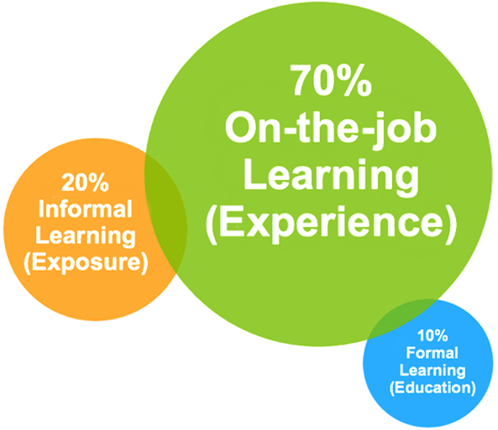
Individual Development Objectives
When deciding which areas to focus development upon, consider the following:
Development needs identified in competency review;
Critical skills and competencies that will be needed to achieve this year’s goals; and
Team Members career aspirations.
Determine what steps can be taken to achieve growth in these areas. Development plans can
include some training but should follow the 70/20/10 learning model:
70% on the job learning
20% learning from others
10% formal training/education
Managers should discuss development goals with their team members.

Slide 20

Smart Goals
Measurable
(video: How to Write a Smart Goal)

Slide 21
SMART Goals
Specific
How will you know you have achieved your goal?
Ask what, when, who & where?
Measurable

Slide 22
SMART Goals
Specific
How will you know you have achieved your goal?
Ask what, when, who & where?
Measurable
How will you measure success along the way and at the end of the goal? Usually stated in terms of quantity, quality, timeliness or cost (e.g. increase by 25%, reduce by $100, etc.).

Slide 23
SMART Goals
Specific
How will you know you have achieved your goal?
Ask what, when, who & where?
Measurable
How will you measure success along the way and at the end of the goal? Usually stated in terms of quantity, quality, timeliness or cost (e.g. increase by 25%, reduce by $100, etc.).
Actionable
Are you capable of attaining/accomplishing this goal? Are there factors beyond their control that need to be considered?

Slide 24
SMART Goals
Specific
How will you know you have achieved your goal?
Ask what, when, who & where?
Measurable
How will you measure success along the way and at the end of the goal? Usually stated in terms of quantity, quality, timeliness or cost (e.g. increase by 25%, reduce by $100, etc.).
Actionable
Are you capable of attaining/accomplishing this goal? Are there factors beyond their control that need to be considered?
Relevant
How is the goal relevant to the company, the team and the individual?

Slide 25
SMART Goals
Specific
How will you know you have achieved your goal?
Ask what, when, who & where?
Measurable
How will you measure success along the way and at the end of the goal? Usually stated in terms of quantity, quality, timeliness or cost (e.g. increase by 25%, reduce by $100, etc.).
Actionable
Are you capable of attaining/accomplishing this goal? Are there factors beyond their control that need to be considered?
Relevant
How is the goal relevant to the company, the team and the individual?
Time Bound
Define the timeframe. When will you start and by when do you want to achieve this goal?

Slide 26
SMART Goals Worksheet Exercise
Initial Goal: Write the goal you have in mind
Specific - What do you want to accomplish? Why is this a goal? Where will it happen? Who needs to be included? When will this happen?
Measurable –How will you measure progress and know if you’ve successfully met your goal?
Actionable – Do you have the skills required to achieve the goal? If not, can you obtain them? Is the goal attainable but challenging.
Relevant – Why am I setting this goal now? Does it align with the Strategic goals?
Time-bound – When do you plan to accomplish this goal by? How long will it take? Is the timeframe realistic?
SMART Goal: Review what you have written, and craft a new goal statement based on what the answers to the questions above revealed.

Slide 27
SMART Goals Worksheet Exercise
Initial Goal: Write the goal you have in mind Implement a online system for residents to report concerns or problems.
Specific - What do you want to accomplish? Why is this a goal? Where will it happen? Who needs to be included? When will this happen?
Measurable –How will you measure progress and know if you’ve successfully met your goal?
Actionable – Do you have the skills required to achieve the goal? If not, can you obtain them? Is the goal attainable but challenging.
Relevant – Why am I setting this goal now? Does it align with the Strategic goals?
Time-bound – When do you plan to accomplish this goal by? How long will it take? Is the timeframe realistic?

Slide 28
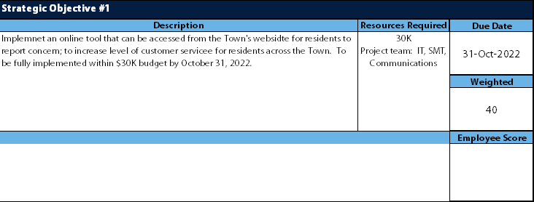
SMART Goals Worksheet Exercise
Weight to be no greater than 65 and no less than 35

Slide 29
Annual Performance Management Cycle
April
April/May
All Year
March/April
Strategic Goal
Setting
Plan & Document Objectives
Execution & Continuous Feedback
Evaluation
Goals Cascaded Down from Council thru the CAO/Director
Departmental/ Divisional Objective Setting for Year
Individual Objective Setting (Strategic & Development)
Documenting on Electronic Forms
Track & Monitor Progress
Continuous Coaching
Providing & Receiving Feedback
Conducting Frequent 1:1 Meetings, Modify Objectives as Needed (periodically, these may be informal)
Self Evaluation
Manager Evaluation
Performance Evaluation Discussion
CAO Calibration
Finalized Annual Performance Evaluation

Slide 30
Execution & Feedback – Individually
Individually:
Track progress on your goals throughout the year and provide regular feedback.
Identify any barriers that may prevent the team member from accomplishing performance objectives and what needs to be done to overcome them.

Slide 31
Execution & Feedback – Managers
Managers
Hold regular 1:1 meetings to discuss performance on goals, provide coaching and feedback.
Video: How to Give Actionable Feedback
Offer effective feedback:
Reinforcing - positive feedback, focused on strengths
Constructive - opportunities, areas for development, redirecting
Offered in a private setting away from others.
Feedback should be objective (FACTS) not subjective (OPINIONS).
4 steps to structuring your feedback:
Step 1: Describe the situation (place, time for event)
Step 2: Describe the behavior you repeatedly see.
Step 3: Describe the impact of the behavior.
Step 4: Suggest an action. What should they stop, start or continue doing.
Notes:
Check volume of video

Slide 32
Performance Management Process Forms
2026/2027

Slide 33


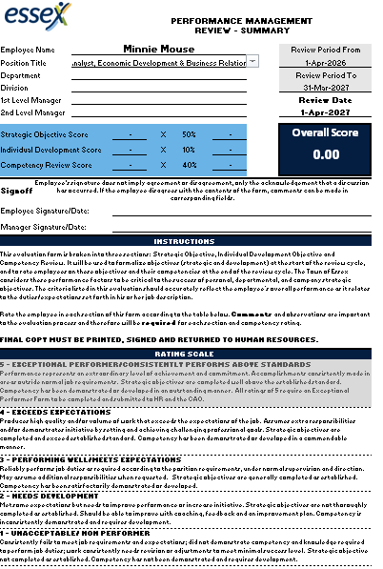


Guess the Year?
Notes:
Passing of Queen Elizabeth, Elon Musk buys Twitter, Colorado Avalanche wins the Stanley Cup, Protesters threw tomato soup on a Van Gough painting, Argentina wins the World Cup and Hurricane Fiona makes landfall in Atlantic Canada
Pope Francis apologizes to Indigenous Communities in Canada for the Church’s role in residential schools

Slide 34
Guess the Year?
2022
Notes:
Passing of Queen Elizabeth, Elon Musk buys Twitter, Colorado Avalanche wins the Stanley Cup, Protesters threw tomato soup on a Van Gough painting, Argentina wins the World Cup and Hurricane Fiona makes landfall in Atlantic Canada
Pope Francis apologizes to Indigenous Communities in Canada for the Church’s role in residential schools

Slide 35
Back to the Beginning..........For Now
Notes:
Why?
End of life for GP and Workzoom.
Difficulties in the system. Process changing even through we havn’t done anything behind the scenes.

Slide 36
Town of Essex Performance Management Process
To be completed now
To be completed ONLY if required
To be completed at year end

Slide 37

Town of Essex Performance Management Process
2. Development Goals

Slide 38

Town of Essex Performance Management Process

Slide 39
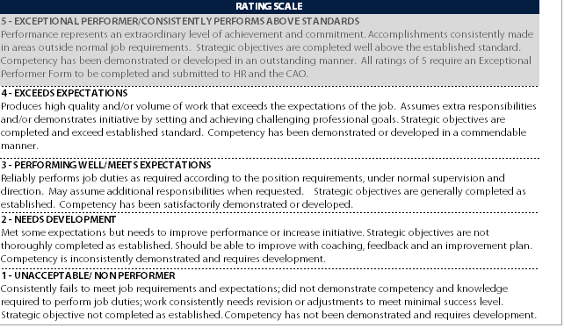
Town of Essex Performance Management Process
2. Development Goals

Slide 40
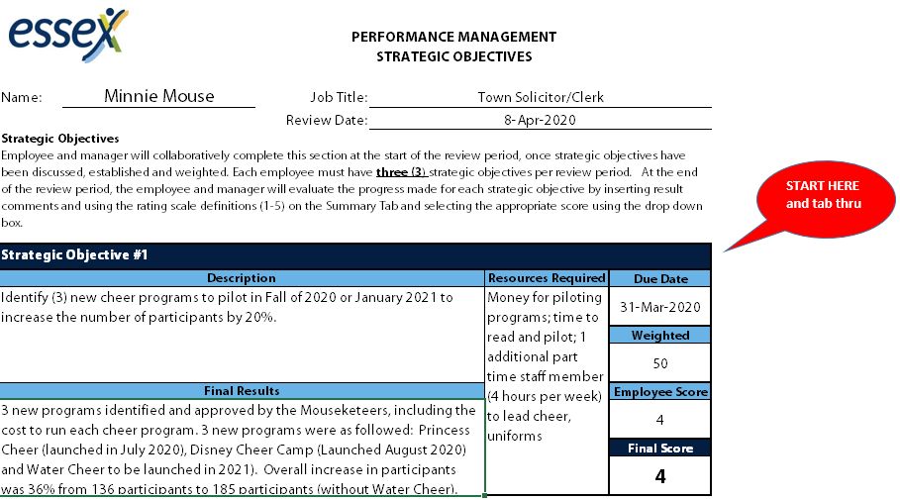
Town of Essex Performance Management Process
2. Development Goals

Slide 41
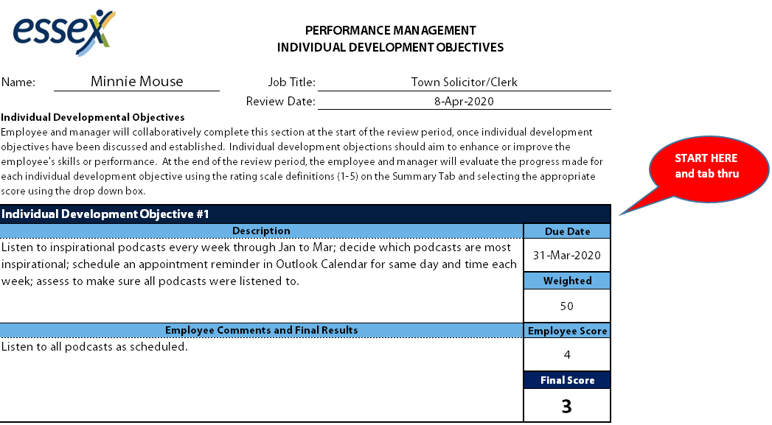
Town of Essex Performance Management Process

Slide 42
Timeline
Date | Action
April 28-May 28, 2026 | Staff and their managers meet to discuss and set goals for new cycle year
May 29th | All new PMP forms with listed goals for 2026-27 cycle to HR for filing
May 30^{th,} - March 31st, 2027 | Have regular conversations with your managers regarding the progress of goals If there are setbacks, discuss options Record as each goals or part thereof is accomplished so not to have to remember it all in March
October 2026 | Review PMP, adjust if necessary and sent updated PMP forms to HR. Reminder will be sent by HR

Slide 43
Resources
1. Planning
Town of Essex 2019-2022 Council Strategic Plan
SMART Goals Worksheet
SMART Goal
2. Execution & Continuous Feedback
Coaching Tips
Feedback Planning Worksheet
3. Evaluation
Goal and Competency Rating Definitions
Competency Definitions

Slide 44

Resources
Find this presentation, the 2026- 2027 PMP Form and other resources on the Wave:
Performance Management - The Essex Wave

